Slide 1


Aralinks Coding Education
Year-end Program Integration Report
Colegio de la Immaculada Concepcion - Gorordo
Report Generation: SY 2025 - 2026

Slide 2

Over
371
{ Coding Sessions }
logged from 6/16/2025 - 4/13/2026 at
Colegio de la Immaculada Concepcion - Gorordo
From curiosity to creation — a year of coding innovation.
© 2025 by The Digital Innovation Department, PPH Digital Media Production Inc.. All Rights Reserved. No part of this document may be reproduced in any form or by any means without written permission from the authors and the publisher.
Notes:
Copy-Paste Logo from this source: https://docs.google.com/spreadsheets/d/1w5JDeGdUT2ewoHLqGuklE8XqYMb1UvhlRGEpNg9PRqc/edit?usp=sharing
Format School logo: Click Logo > Right Click > Order > Send to back

Slide 3

The Aralinks Coding Education (ACE) Program continued to support innovative learning at Colegio de la Immaculada Concepcion - Gorordo throughout school year 2025 - 2026.
Students engaged in hands-on coding experiences that fostered creativity, problem-solving, and collaboration. These activities enabled learners to progress from foundational coding exercises to creating meaningful computational projects.

Slide 4

Implementation Overview
The ACE program empowers learners by integrating technology and computational thinking into core subjects.
Here’s a quick overview of the Colegio de la Immaculada Concepcion - Gorordo implementation setup:
Grade Levels: | 1 - 12
Adoption Year: | 2025
Adoption Type: | Both Software & Hardware
Implementation Year: | 1st
Implementation Setup: | 10 Makey-Makey 10 Microbit v.2 10 Arduino Uno Kit 20 Raspberry Pi
Schedule Arrangement: | Fixed Schedule
Notes:
Adoption Type, overwrite with:
Software-based use > Software-based / Creative Coding
Hardware-based use > Hardware-based / Physical Computing
Combo: Creative Coding + Physical Computing
Implementation Setup, overwrite with:
Subject Integration
Subject Integration + Dedicated Coding Hour/s
Subject Integration + Computer Subject
Integrated with Computer Subject
Additional Subject (ACE)
Elective - Academic
Elective - Co-curricular
Schedule Arrangement:
Fixed Schedule
Scheduled by Subject Area/s involved
Fixed Schedule and integrated

Slide 5



The ACE-nnovators at a Glance
The success of ACE at Colegio de la Immaculada Concepcion - Gorordo lies in the collective brilliance of its educators and students.
Grade School
Junior HS
Senior HS
TOTAL
61
486
678
239
1403
Student Coders
Participating Teachers
12 Sections
17 Sections
8 Sections
37 Sections
The program’s strength is grounded in collaboration: educators who guide with purpose, and learners who code with imagination. Each class becomes a hub of exploration — where logic meets creativity, and learning shifts from passive consumption to active creation.
Notes:
put (-) or n/a if division is not part of adoption

Slide 6
Schoolwide Coding Engagement - By the Numbers
A snapshot of Grade School coding engagement—by the numbers.
Coding Sessions Logged
Coding Hours Delivered
Activities Count
Computational Artifacts Created
371
306
5
26
* Includes 0 mixed/ancillary sessions
Average of 30.17 coding sessions delivered per grade level across all terms this school year.
Equivalent to 25.14 average coding hours per grade level across all terms this school year.
Reflects the diversity of coding learning experiences across grades.
Highlights the coding outputs and project work learners created throughout the terms.

Slide 7
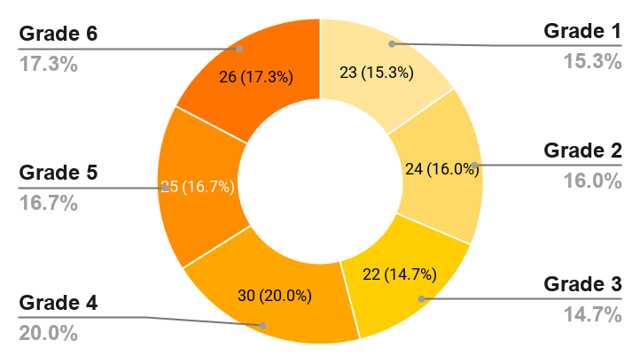
Grade School Coding Session Breakdown
A closer look at how Grade School learners engaged with coding this school year.
Grade Level | 1st Half | 2nd Half | Total
1 | 15 | 8 | 23
2 | 12 | 12 | 24
3 | 12 | 10 | 22
4 | 15 | 15 | 30
5 | 13 | 12 | 25
6 | 14 | 12 | 26
Coding sessions varied across grade levels over the course of the year. During the first half of the year, Grade 1 (15), Grade 4 (15) logged the most sessions, while in the second half, Grade 4 (15) recorded the highest overall engagement.
Coding sessions in the grade school were relatively distributed across grade levels, ensuring that each cohort received meaningful opportunities to learn, code, and create.
Notes:
[Slide for school with Grade School adoption] / Delete when necessary.
Explainer options:
Relatively distributed – Coding sessions in the grade school were relatively distributed across grade levels, ensuring that each cohort received meaningful opportunities to learn, code, and create.
Focused on priority levels – Coding sessions in the grade school were intentionally focused on priority grade levels, supporting deeper engagement and stronger mastery where it was most needed.
Concentrated in specific levels – Coding sessions in the grade school were concentrated in specific grade levels, reflecting scheduling priorities and the school’s implementation approach.
Driven by schedule/capacity – Most coding sessions in the grade school were delivered to grade levels with available schedules and teacher capacity, providing focused support where learners could benefit most.
Concentrated in upper levels – Coding sessions in the grade school were heavily concentrated in upper grade levels, highlighting increased readiness and demand for more advanced coding experiences.
Evenly balanced – Coding sessions in the grade school were more evenly balanced across grade levels, indicating broad access to coding experiences throughout the school.

Slide 8
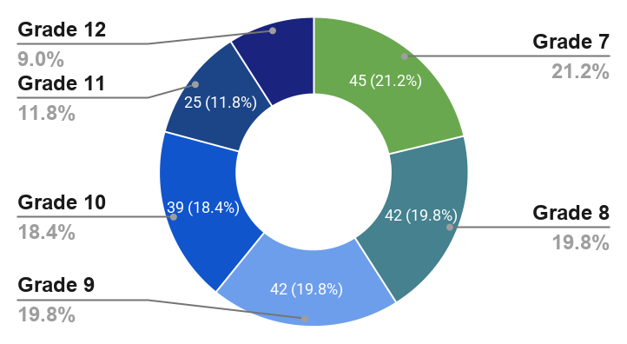
High School Coding Session Breakdown
A closer look at how High School learners engaged with coding this school year.
Grade Level | 1st Half | 2nd Half | Total
7 | 19 | 26 | 45
8 | 23 | 19 | 42
9 | 21 | 21 | 42
10 | 17 | 22 | 39
11 | 11 | 14 | 25
12 | 12 | 7 | 19
High school coding sessions varied across grade levels over the course of the year. During the first half, Grade 8 (23) logged the most sessions, while in the second half, Grade 7 (26) recorded the highest overall engagement.
Coding sessions in the high school were more evenly balanced across grade levels, indicating broad access to coding experiences throughout the school.
Notes:
[Slide for school with High School adoption] / Delete when necessary.
Explainer options:
Relatively distributed – Coding sessions in the high school were relatively distributed across grade levels, ensuring that each cohort received meaningful opportunities to learn, code, and create.
Focused on priority levels – Coding sessions in the high school were intentionally focused on priority grade levels, supporting deeper engagement and stronger mastery where it was most needed.
Concentrated in specific levels – Coding sessions in the high school were concentrated in specific grade levels, reflecting scheduling priorities and the school’s implementation approach.
Driven by schedule/capacity – Most coding sessions in the high school were delivered to grade levels with available schedules and teacher capacity, providing focused support where learners could benefit most.
Concentrated in upper levels – Coding sessions in the high school were heavily concentrated in upper grade levels, highlighting increased readiness and demand for more advanced coding experiences.
Evenly balanced – Coding sessions in the high school were more evenly balanced across grade levels, indicating broad access to coding experiences throughout the school.

Slide 9
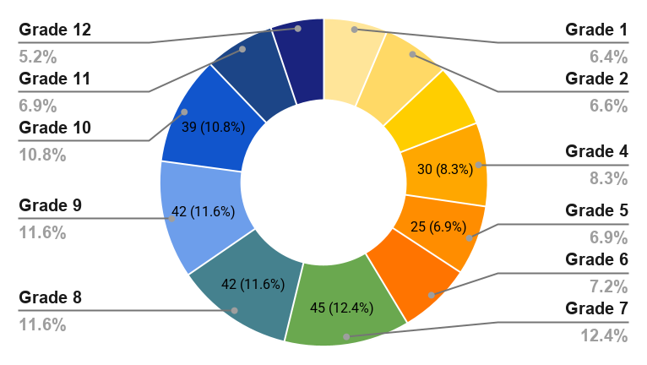
All Grade Levels Coding Session Breakdown
Coding session breakdown of all grade levels learners engaged with ACE this school year.
Grade | 1st Half | 2nd Half | Total
1 | 15 | 8 | 23
2 | 12 | 12 | 24
3 | 12 | 10 | 22
4 | 15 | 15 | 30
5 | 13 | 12 | 25
6 | 14 | 12 | 26
7 | 19 | 26 | 45
8 | 23 | 19 | 42
9 | 21 | 21 | 42
10 | 17 | 22 | 39
11 | 11 | 14 | 25
12 | 12 | 7 | 19
Schoolwide coding sessions varied across grade levels, showing different coding activity focus at each grade. Grade 7 (45) recorded the highest number of coding sessions, followed by Grade 8 (42), Grade 9 (42), while Grade 12 (19) had the fewest among grade levels with recorded sessions.
Across the school, coding sessions were relatively balanced by grade level, suggesting broad access to coding opportunities.
Notes:
[Slide for school with GS and High School adoption] / Delete when necessary. I.e. department specific report.
Explainer options:
Balanced pattern - “Across the school, coding sessions were relatively balanced by grade level, suggesting broad access to coding opportunities.”​​
Clearly focused on certain grades - “Coding activity was most concentrated in a small set of grade levels, reflecting where scheduling and implementation efforts were strongest.”
Skewed toward upper grades - “Sessions tended to cluster in the upper grades, where learners engaged more frequently in extended coding experiences.”​​
Skewed toward lower grades - “Sessions were more frequently scheduled in the lower grades, laying a stronger early foundation for coding skills.”
Presence of grades with zero sessions - “At the same time, some grade levels had little to no recorded activity, pointing to potential areas for future expansion.”

Slide 10

Schoolwide Coding Activities
From sessions to projects, here’s how coding unfolded across the terms.
Activities Count
Activities Conducted
2
Onboarding (187)
Student Orientation (6)
Mid-year
4
Onboarding (112)
Project Creation (61)
Build and Code Session (3)
Coding Session (2)
2nd half
Notes:
You may add this statement when applicable:
When activities are similar
Mid-year and second-half featured a comparable spread of activities, showing consistent opportunities for students to engage in coding across the terms.
Activity types remained stable across both periods, indicating a steady pattern of onboarding, project work, and presentations throughout the year.
When mid‑year is more orientation/onboarding heavy
Mid-year placed greater emphasis on onboarding and orientation, helping students ease into the program before taking on more demanding coding tasks later in the year.
Early in the year, activities focused on student orientation and onboarding, laying the groundwork for more complex coding work in subsequent terms.
When the second half shifts toward projects/outputs
In the second half of the year, activities shifted toward project creation and presentations, reflecting a stronger focus on applying and showcasing students’ coding skills.
Later in the year, coding activities emphasized exam days, project work, and competitions, signaling a move from foundation-building to performance and output.
When a showcase or schoolwide event stands out
The presence of schoolwide events such as ShowcACE highlighted coding as a visible part of the school culture, bringing together learners from multiple grade levels.
Schoolwide showcase activities played a key role, creating public moments for students to present their coding projects and celebrate progress.
When competitions or external events appear
The addition of local and international competitions in the second half provided authentic venues for students to test their coding skills beyond regular classes.
Competitive events complemented classroom activities, giving interested students higher‑stakes opportunities to extend their coding experience.
When research or consultation appears
Research and consultation activities, though fewer in number, signaled deeper, more individualized engagement for students refining specific projects.
Teacher and student consultation sessions supported more personalized guidance, especially for learners preparing for exams, showcases, or competitions.

Slide 11
Schoolwide Coding Activities
Activities Count
Activities Conducted
5
Onboarding (299)
Project Creation (61)
Student Orientation (6)
Build and Code Session (3)
Coding Session (2)
Year-end
Across the first and second halves of the year, schoolwide coding activities moved learners through the full cycle—from orientation and onboarding to project creation, presentation, and reflection. Together, these activities show students engaging more confidently with coding over time and highlight the strong partnership between teachers and the ACE program in sustaining that growth.
Notes:
Set 1 – When activity mix is broadly similar
Across the first and second halves of the year, students experienced a mix of onboarding, project work, and presentations, keeping them engaged in coding from start to finish. Both periods offered comparable opportunities to begin, build, and share projects, showing how coding stayed a consistent part of school life all year.
Set 2 – When the year shows a clear shift from foundation to output
In the first half of the year, activities focused more on orientation, onboarding, and early project work, giving students time to build confidence with coding tools and routines. By the second half, the mix shifted toward project creation, presentations, and assessments, highlighting how learners moved from foundation‑building to applying and showcasing what they had learned.
Set 3 – When the year highlights big, visible events and extensions
Across both halves of the year, a rich set of activities—from onboarding and project development to showcases, exams, and competitions—kept students actively using and extending their coding skills. Schoolwide events, presentations, and contests turned coding into a visible celebration of student work, while regular sessions and check‑ins ensured that progress was supported throughout the year.

Slide 12

Subject Integration / Coding Anchor Subjects
Every activity delivered in the past terms stemmed from how the school structured coding within its curriculum.
Subjects Count
Subject/s Involved
1
Fixed Coding Sessions (124)
Mid-year
1
Fixed Coding Sessions (178)
2nd-half
Notes:
If too many subjects in a term, duplicate split terms.
Explainer Options:
Coding was delivered through a dedicated subject period, giving learners structured time and consistent exposure to build skills progressively throughout the term.
Coding was integrated across multiple subjects, allowing learners to apply computational thinking within different learning contexts and deepen cross-disciplinary skills.
The school used a mixed model—dedicated coding time alongside subject integration—to broaden learning opportunities and reinforce skills across contexts.

Slide 13
Subject Integration / Coding Anchor Subjects
Subjects Count
Subject/s Involved
1
Fixed Coding Sessions (302)
Year-end
Coding at Colegio de la Immaculada Concepcion - Gorordo was integrated across multiple subjects, allowing learners to apply computational thinking within different learning contexts and meaningfully deepen their cross‑disciplinary skills all year.
Notes:
Dedicated Subject Periods
Coding was delivered through dedicated subject periods, providing learners with structured time, consistent exposure, and progressive skill‑building in computational thinking that successfully strengthened their abilities throughout the year.
Integrated Across Subjects
Coding was integrated across multiple subjects (English, Math, Science), allowing learners to apply computational thinking within different learning contexts and meaningfully deepen their cross‑disciplinary skills all year.
Mixed Model Approach
The school used a mixed model—dedicated coding periods alongside subject integration—to maximize opportunities, reinforce skills across contexts, and deliver a highly effective program tailored to each school's unique implementation.
Paired with ACE Electives
Coding was paired with ACE elective subjects (Academic or Co‑curricular), extending learning beyond regular classes while successfully connecting coding to broader academic and extracurricular achievements throughout the year.
Scheduled by Subject Area
Coding sessions were scheduled by subject area, ensuring teachers could weave computational thinking into their lessons at optimal times for maximum relevance, impact, and sustained learner success.
Fixed Schedule with Computer
Coding followed a fixed schedule integrated with Computer subject, creating predictable time for hands‑on practice that consistently built strong ICT and coding proficiency across the school year.

Slide 14


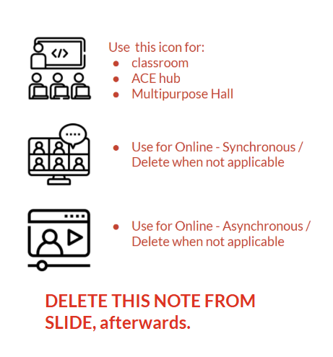


Coding Session Modalities
Subject scheduling shaped how learners accessed coding.
Here’s how sessions were delivered this year.
Com Lab (365)
Classroom (6)
Most coding sessions this school year were conducted in the ACE Hub. To maximize coding opportunities next year, the school may explore a fuller mix of modalities, combining ACE Hub sessions with classroom-based or online activities to sustain learning even during tight schedules or shifting conditions.
Notes:
Explainer options (for variation)
The school may further strengthen coding next year by diversifying delivery modalities—expanding computer ACE Hub sessions, integrating classroom-based activities, or incorporating online formats to support flexibility and continuity.
To maximize coding opportunities next year, the school may explore a fuller mix of modalities, combining ACE Hub sessions with classroom-based or online activities to sustain learning even during tight schedules or shifting conditions.
Coding can be amplified next year by using multiple delivery modes, more ACE Hub/computer lab time, flexible online sessions, or classroom-based integration.
A broader use of modalities next year — ACE Hub/computer lab, classroom, and online — can help the school distribute sessions more effectively, boost participation, and maintain learner progress despite scheduling constraints.

Slide 15
Computational Artifacts Created
From how they learned to what they created — here’s a look at the projects and computational artifacts produced this school year.
Total Computational Artifacts Created
Projects Type Count
Projects Created
Interactive Storybook (17)
Educational App (9)
2
26
The artifacts created this year show that learners are moving from practice to purposeful creation—an important step in developing real-world digital skills.

Slide 16

Active Teachers
This year's implementation was strengthened by teachers who regularly partnered with the ACE program to deliver coding experiences.
Jessa Abejaron (72)
Felda Alpuerto (64)
Theresa Cantillas Peñafor (57)
John Michael G. Maro (20)
Kristelle Gem Salazar (12)
Anne Erica Trinidad (11)
Kristine Jay B. Ursal (8)
Arvina Opura (7)
Maria Angelika Niña A. Mendoza (7)
Lauren Fhel A. Quinio (5)
Maria Victoria L. Olid (5)
Hannah Pearl Mahinay (1)
COUNT
12

Slide 17

ACE Facilitator/s
Guiding the program’s implementation is the school’s ACE Facilitator, serving as its dedicated coding instructor.
COUNT
2
Mr. Francis Justin Cutamora
Mr. Richard Quirante
The ACE Facilitator extended support across a wide range of learning activities this year —from orientations, onboarding, coding and build-and-code sessions to project creation, revisions, presentations, consultations, and schoolwide events.
School administrators and teachers are encouraged to continue coordinating closely with the ACE Facilitator to explore additional strategies and opportunities that can further strengthen the school's implementation of the ACE Program next year.
Notes:
Edit Manually
Options:
The ACE Facilitator extends support across a wide range of learning activities—from orientations, onboarding, coding and build-and-code sessions to project creation, revisions, presentations, consultations, and schoolwide events.
The ACE Facilitator supports activities ranging from orientations and coding sessions to project work, consultations, and schoolwide showcases.
Recommendatory lines;
To further maximize the impact of the ACE Program, the school administration is advised to regularly engage with the ACE Facilitator when planning schedules, strengthening integration, or expanding coding activities.
For further optimization of the ACE Program, the school may consult the ACE Facilitator for guidance and implementation support.

Slide 18

This year, the school's coding program achieved remarkable growth.
The ACE Facilitator, together with the Phoenix Aralinks team, delivered comprehensive support that strengthened
student learning and teacher capacity.
With continued partnership and commitment,
even greater success awaits.
#ACEPossible!

Slide 19
Contact Information for Further Support
For any inquiries or assistance related to the Aralinks Coding Education (ACE) program, feel free to reach out to our dedicated support team:
Aralinks Supervisor: Emmanuel Timtim
Email: etimtim.did@gmail.com
Aralinks EdTech: Mark Joseph del Rosario
Email: mjdelrosario.did@gmail.com

